Slide 1


MobiCom 2019
OFDMA Enabled Wi-Fi Backscatter
Renjie Zhao, Fengyuan Zhu, Yuda Feng, Siyuan Peng,
Xiaohua Tian, Hui Yu, Xinbing Wang
Oct. 22, 2019

Slide 2
Outline
Introduction
Technical contributions
Main results
Notes:
This is my outline.

Slide 3
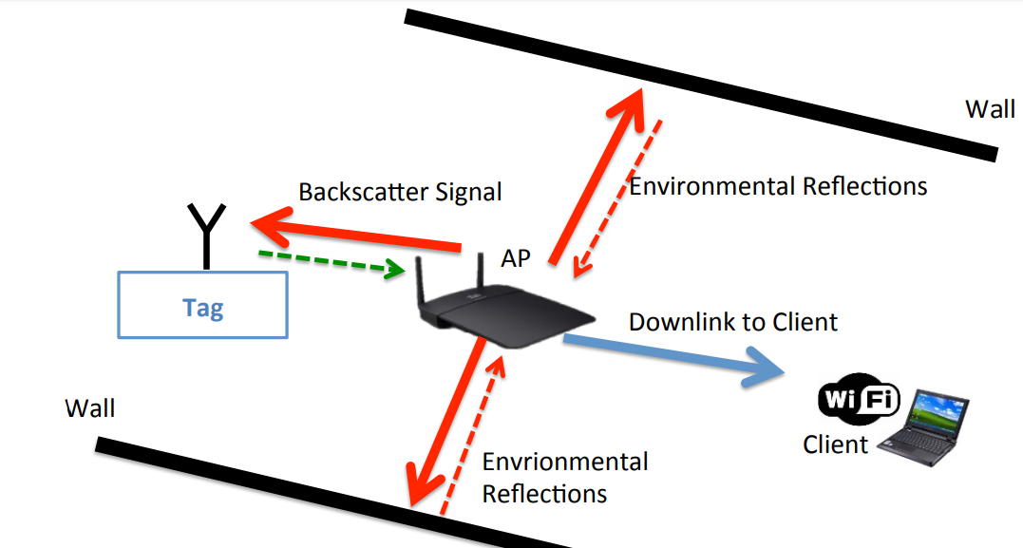
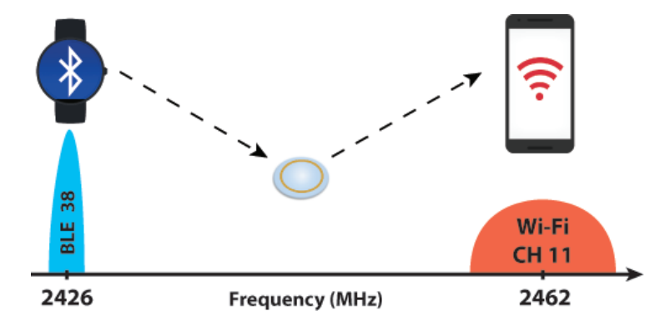
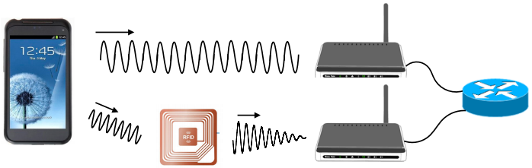
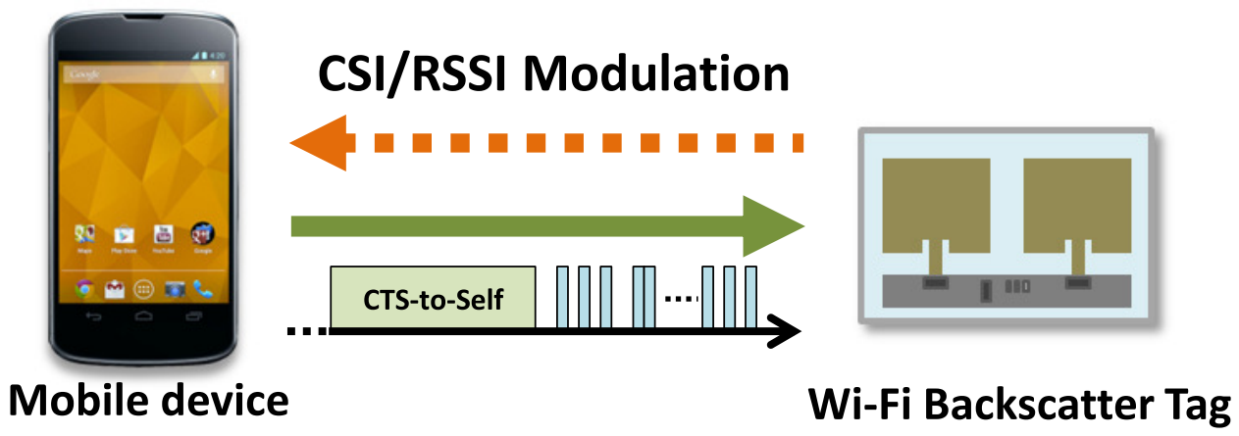
Wi-Fi backscatter
Ultra-low power wireless communication leverage Wi-Fi
Wi-Fi backscatter
BackFi
Passive Wi-Fi
InterScatter
HitchHike
FreeRider
Wi-Fi channel
modulation
Frequency
shifting
Cross technique
communication
Codeword
translation
Full duplex
SIGCOMM 2014
SIGCOMM 2015
NSDI 2016
SIGCOMM 2016
SenSys 2016
CoNext 2017
3
Notes:
Wi-Fi backscatter realize ultra-low power wireless communication leveraging Wi-Fi signals or infrastructures.
Recent years have witnessed active efforts in developing this technique. There are a series of papers as shown here.

Slide 4

Wi-Fi itself evolving
Higher single-connected peak rate
Higher over-all capacity
Wi-Fi BS
BackFi
InterScatter
Passive Wi-Fi
HitchHike & FreeRider
802.11 a/b/g/n
11 ac Wave1
11 ac Wave2
11 ax
Single-carrier/
OFDM
SU-MIMO
MU-MIMO
OFDMA
4
Notes:
While creative and promising, the backscatter schemes mentioned above are based on old Wi-Fi techniques. The main focus was on having higher single-connected peak rate which is not suitable for IoT scenario.
In fact, the next generation Wi-Fi 11ax support orthogonal frequency division multiple access (OFDMA) which allows multiple devices to transmit at the same time. The focus has been switched to have higher over-all capacity.

Slide 5
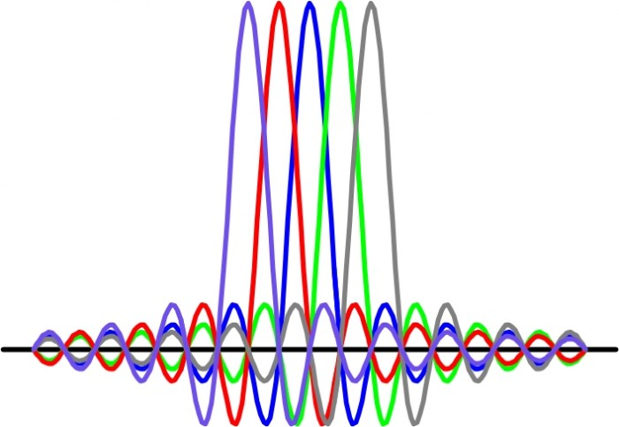
OFDM vs OFDMA
1
2
3
4
5
6
7
8
9
10
11
Wi-Fi Channel
2.4GHz
2.412GHz
2.437GHz
2.462GHz
Spectrum strength
Single-carrier
Single-carrier
modulation,
eg., 802.11b
frequency
Spectrum strength
Subcarriers
OFDM,
eg., 802.11a/g/n
frequency
OFDMA
eg., 802.11ax
5
Notes:
Comparing to the single carrier modulation and the OFDM scheme which can support at most three concurrent transmission occupying the three non overlapping channel, OFDMA can allocates the ORTHORGNAL subcarriers to different devices. This method provides higher concurrency and can avoid the large overhead introduced by anti-collision mechanism especially when the number of devices are large.

Slide 6
OFDMA Wi-Fi backscatter
tag
Transmitter sends out continuous wave (CW)
Tag performs frequency shift, backscattered symbol lies on an OFDM subcarrier freq.
6
Notes:
Therefore, in our work, we show how to realize OFDMA in Wi-Fi backscatter to make it more suitable for IoT scenario without hardware modification requirement on Wi-Fi infrastructure. The basic idea is fairly simple. The transmitter sends out continuous wave, the tag perform frequency shift so that the backscattered symbol lies on a sub-carrier frequency.

Slide 7
OFDMA Wi-Fi backscatter
Transmitter sends out continuous wave (CW)
Transmitter sends out continuous wave (CW)
Tag performs frequency shift, backscattered symbol lies on an OFDM subcarrier freq.
Multiple tags, work in different subcarriers frequencies, backscattered symbols
combined to form an OFDM symbol at the receiver
7
Notes:
When have multiple tags, the tags generate backscattered symbols at multiple orthogonal subcarriers. When those backscattered symbols arrive at the receiver, they are naturally combined to form a new OFDM symbol, which is to be decoded by the receiver.

Slide 8
Outline
Introduction
Technical contributions
Main results
Notes:
This is my outline.

Slide 9
Technical challenges
Synchronization
Time domain synchronization
- All entities agree on the starting time point and duration of the OFDM symbol
Frequency domain synchronization
- All communication parties keep frequency orthogonality among subcarriers
More challenging
- Introduction of tags, increase hardware diversity and propagation uncertainty
9
Notes:
The crux of any OFDMA system is to realize strict synchronization. That is, all the communication entities should agree on the starting point and duration of the OFDM symbol in the time domain, and should agree on the carrier frequency and maintain frequency orthogonality in the frequency domain.
For the OFDMA backscatter, the synchronization requirement is even more challenging, because backscattering tags introduce more uncertainties, including the hardware diversity and the location diversity.
In order to realize OFDMA backscatter, the following specific challenges have to be resolved.

Slide 10
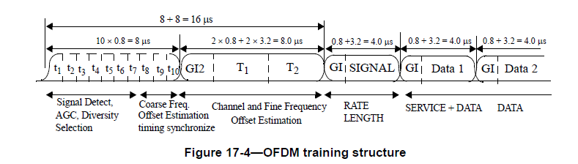
Challenge-1：Calibrating clock offsets
Preamble
OFDM clock
synchronization
802.11g PHY frame structure
Single tone
Backscattered signal
OFDMA backscatter
How to synchronize tags with TX, RX?
10
Notes:
For the regular OFDM system, the transmitter sends a preamble to do the clock synchronization and packet detection.
In comparison, the OFDMA backscatter system introduces reflecting tags. We need to synchronize the tags with TX and RX so that the backscattered signal can be combined as an eligible OFDM symbol.
A straightforward idea is to let tags generate preambles; however, such a solution can incur messaging overhead for coordinating tags. Furthermore, since the hardware and location diversity, the generated preamble might be distorted and may not be able to trigger the demodulating procedure.

Slide 11
Solution：Synchronization with TX
11
Notes:
To resolve the synchronization issue, we first maintain the preamble between TX and RX in the regular OFDM system to let the receiver to be synchronized with the transmitter. The transmitter then sends OOK modulated signal which contains a pre-known sequence, in order to synchronize the tags with the transmitter. OOK is adopted to satisfy the low power requirement on tags. In this way, all the entities are basically synchronized with the transmitter. After that, the CW are sent to the tags for backscattering.
The final transmitted waveform is as shown below. Please refer to our paper on how to generate this kind of waveform with OFDM architecture.

Slide 12
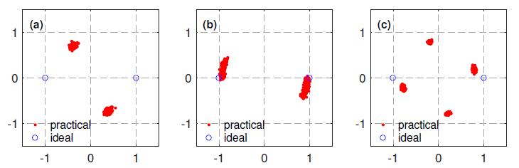
Challenge 2: Calibrating phase offsets
Practical case
Ideal case
(a) Static phase offset
(b) Continuous dynamic
phase offset
(c) Discrete dynamic phase offset
12
Notes:
After the previous synchronization, the system is still not completely synchronized. If we observe the constellation diagram of a BPSK modulated signal at the receiver’s side, we can see the following 3 phase offsets. The blue circle shows the ideal case and the red cluster shows the practical case. We have to figure out why the offsets occur and how to calibrate them.

Slide 13
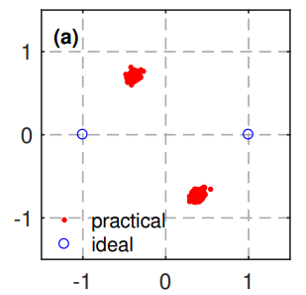
Challenge 2: Calibrating phase offsets
(a) Static phase offset
θ
-1
+1
13
Notes:
The phenomenon of static phase offset is like this. The total constellation diagram has a rotation of one random theta degree. The theta is static during one OFDM burst but random among different bursts and different tags.

Slide 14
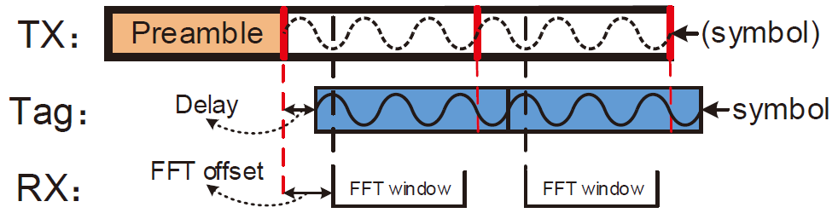
Challenge 2: Calibrating phase offsets
(a) Static phase offset – cause and solution
Root cause of static phase offset
14
Notes:
What cause this problem?
After the synchronization between TX and tag, there is still a delay between tag symbol clock and transmitter symbol clock which is caused by on-tag circuit delay, tx-to-tag preamble processing delay and the longer propagation delay. These delays finally result in a static phase offset. And the difference of the delay among different bursts and different tags makes the offsets random.
The RX can easily estimates the static phase offset and then calibrates it by adding a tag to RX preamble.

Slide 15
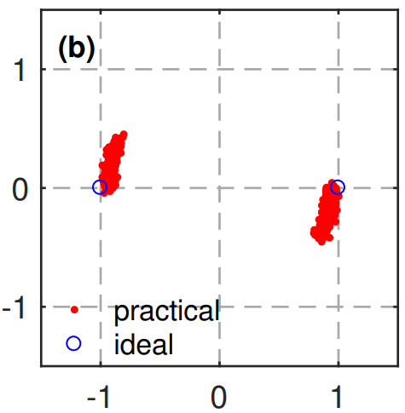
Challenge 2: Calibrating phase offsets
(b) Continuous dynamic phase offset
-1
+1
15
Notes:
The phenomenon of continuous dynamic phase offset is that the points in the constellation diagram rotates continuously. And finally the constellation diagram become a circle.

Slide 16
Challenge 2: Calibrating phase offsets
(b) Continuous dynamic phase offset - cause
No residual frequency offset calibration
16
Notes:
For a regular OFDM system, between the transmitter and receiver, there is pilot signal which can be used for residual offset calibration. But there is no such calibration mechanism with tags.

Slide 17
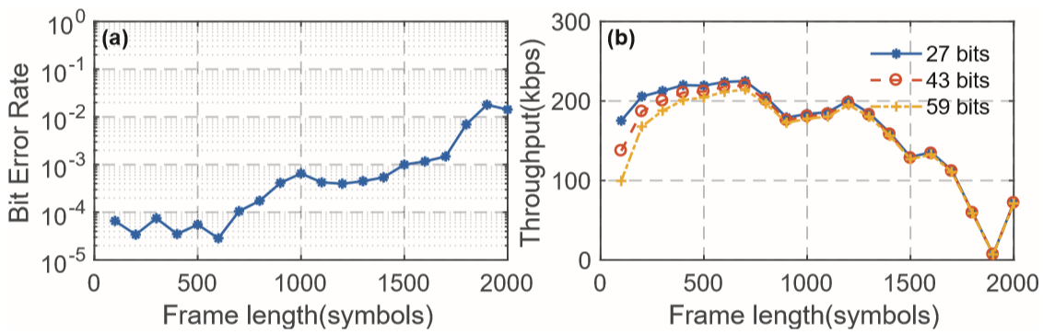
Challenge 2: Calibrating phase offsets
(b) Continuous dynamic phase offset - solution
Experiments, frame length = 500 symbols, balance BER and throughput
17
Notes:
The final residual offset between tags and receiver depends on the tags clock which is much slower than RF carrier. So in fact the rotating is not that fast. Based on an experiment on the performance over the frame length. We found that with frame length shorter than 500, the performance is not severe affected.
Therefore, with controlled frame length this offset will not introduce too much performance degradation while avoiding unnecessary modification on Wi-Fi infrastructure.

Slide 18
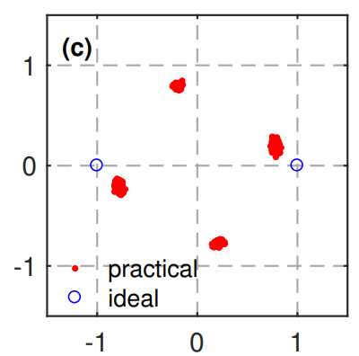
Challenge 2: Calibrating phase offsets
(c) Discrete dynamic phase offset
-1
+1
18
Notes:
The phenomenon of discrete dynamic phase offset is that the constellation diagram of BPSK signal will result in a constellation diagram like QPSK signal.

Slide 19
Challenge 2: Calibrating phase offsets
(c) Discrete dynamic phase offset - cause
Symbol 1
Symbol 2
Symbol 3
Square wave period
Not integer multiples
Symbol period
19
Notes:
Discrete dynamic phase offset is caused by tag modulation process.
Because of the existing of Cyclic prefix, the symbol period is not necessarily integer multiples of the square wave period.

Slide 20
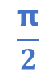
Challenge 2: Calibrating phase offsets
(c) Discrete dynamic phase offset - cause
Symbol 1
Symbol 2
Symbol 3
0
$$\frac{\text{π}}{2}$$
π
Initial phase each symbol → rotating BPSK modulation
20
Notes:
Therefore, the initial phase of each symbol will be different between RX reference and the tag symbols. As shown here as 0, half pi and pi. Then the modulation on the tags will be some kind of rotating BPSK modulation. This can be calibrated on the tag since the initial phase offset is known when the subcarrier is known.

Slide 21
Outline
Introduction
Technical contributions
Main results
Notes:
This is my outline.

Slide 22
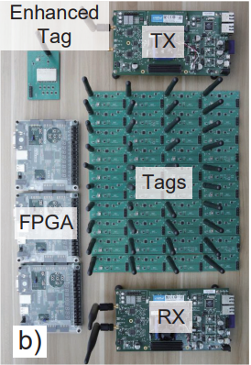
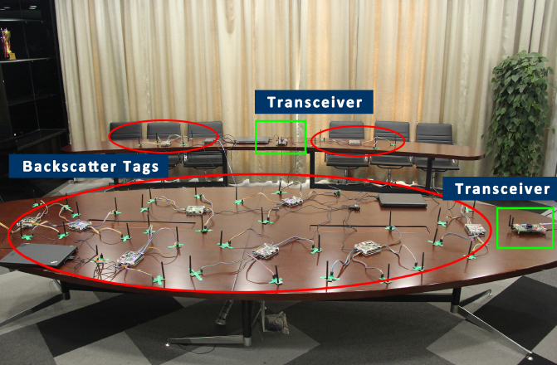
Prototype and environment
22
Notes:
We implement a testbed with WARP board, FPGA and COTS components, and conduct experiments in our lab.

Slide 23
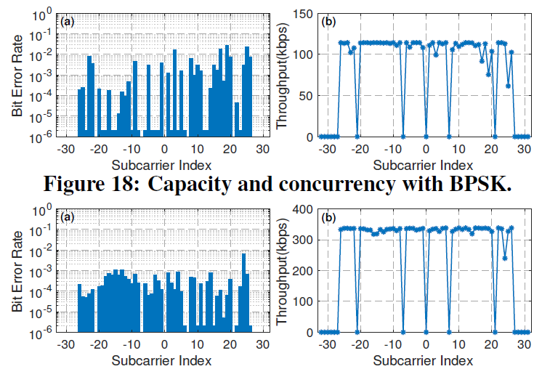
Concurrent OFDMA transmissions
BPSK, BER and throughput
QPSK, BER and throughput
48× concurrency; 5.2Mbps and 16Mbps aggregate throughput.
23
Notes:
These two figures shows the performance of concurrent communication. With BPSK and QPSK respectively. The system can support 48 concurrently transmission and the aggregate throughput can be up to 16Mbps.

Slide 24
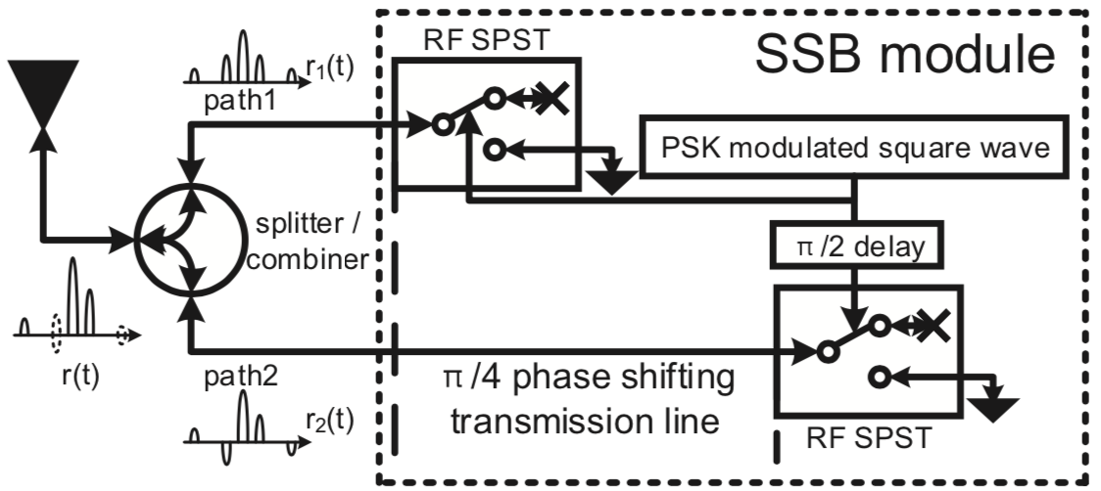
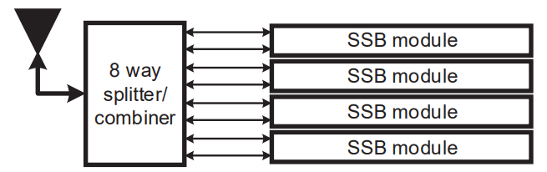
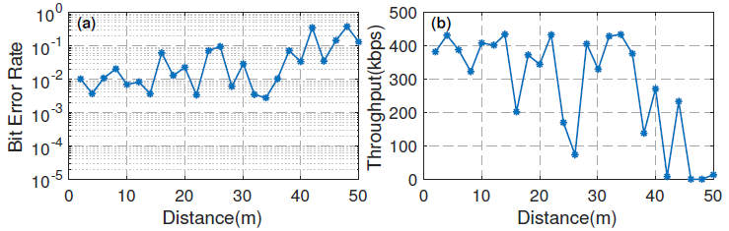
Enhanced tag
Regular tag
Integrate 4 regular tags into 1 enhanced tag
4× throughput, support heterogeneous connectivity
24
Notes:
We could flexibly aggregate 4 backscatter modules into an enhanced tag, this tag could be assigned 4 subcarriers and achieve 4 times of throughput compared with the regular one.

Slide 25
Summary
First Wi-Fi backscatter system supporting OFDMA
Manage to realize strict system synchronization
- Customize excitation signal
- Calibrating clock offsets
- Calibrating phase offsets
Performance
- 48 concurrency
- 2x distance and 1.45-5× data rate
- Tens of µW power consumption on tag
Notes:
Here is the summary of our system. Any question will be appreciated.

Slide 26
MobiCom 2019
Thank you very much!
Q & A
Renjie Zhao, Fengyuan Zhu, Yuda Feng, Siyuan Peng,
Xiaohua Tian, Hui Yu, Xinbing Wang
Oct. 22, 2019

